Slide 1
30 Years of Investing
in Rural Leadership
Valerie Shangreaux, Ph.D.
Director of Blandin Leadership Programs

Slide 2
Introductions
Your Name
Where You Work
A strength you bring to your work

Slide 3
Overview
Blandin Community Leadership Programs
Notes:
Purpose of the Program: to develop and sustain healthy community by building on community strengths. While the training contains individual leadership development, the application of skills taught is all focused on the participant’s community of place. It also focuses on building relationships across the cohort so that leaders don’t have to act alone.
Healthy Community implies …
Realistic
Interconnected
Process Oriented
A Healthy Community is… A place to live where all people can:
Meet their needs (economic, social, physical, cultural, and spiritual).
Work together for the common good.
Participate in creating their future.

Slide 4
Lesson #1:
Leadership matters
Notes:
This is why we take investing in leadership so seriously. Leaders are a critical resource for communities. The quality and quantity of leadership that exists in a community is indispensable. What’s more, there is tremendous capacity in rural leaders and places to make great things happen.
In the Blandin Community Leadership Program we define Community Leadership as doing what need to be done to develop and sustain healthy community.
Almost daily we hear amazing stories about what our alumni are doing in their communities. We also actively stay close to what leaders are saying about themselves and their communities
Every 3 years we conduct a perception survey we call the rural pulse. Here are just a few things we at the Blandin Foundation know about rural leaders:

Slide 5
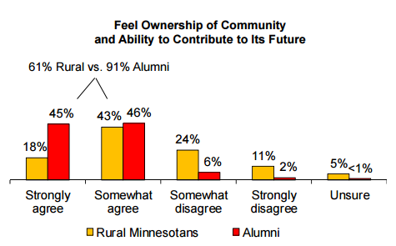
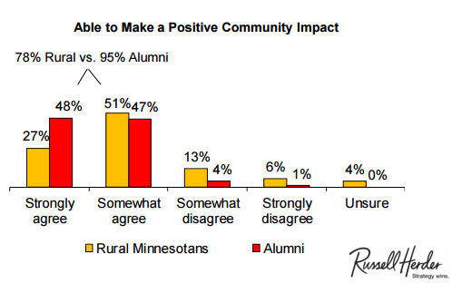
Ready to Engage
Notes:
READY to ENGAGE
91% of leaders say they are able to contribute to the future of their communities
95% believe they can make a positive community impact

Slide 6
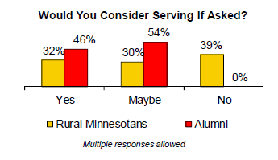
100%
Notes:
100 percent say that, if asked to serve as leaders, they would say yes or maybe

Slide 7
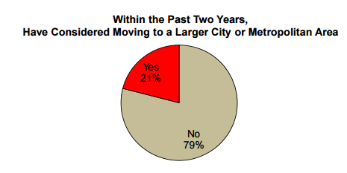
The long haul
Notes:
IN IT FOR THE LONG HAUL
79 percent say they have not considered moving in the last 2 years = rural leaders tend to stay (long-term resource)

Slide 8
Lesson #2:
Build on hope!

Slide 9
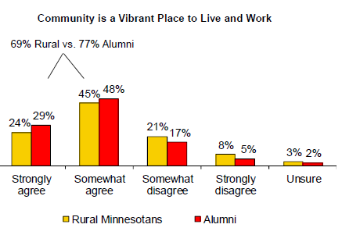
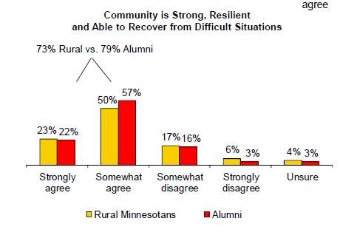
Hope
Notes:
One thing our 30 years of experience has taught us is that community leadership is hard work! We know to people are better equipped to do their best work when focused on strengths rather than deficits.
Rural communities leaders are hopeful, ready and eager to engage and have the resources/capacity to do what it takes to build and sustain healthy community
HOPE
77 percent of rural MN leaders say their community is a vibrant place to live and work
79 percent – community is strong and resilient, able to recover from difficult situations

Slide 10
Lesson #3
Leadership can come
from anywhere
Notes:
Multiple perspectives in the room
9 Dimensions of Healthy Community (SLIDE)
Gender balance
Est/Emerging leaders

Slide 11
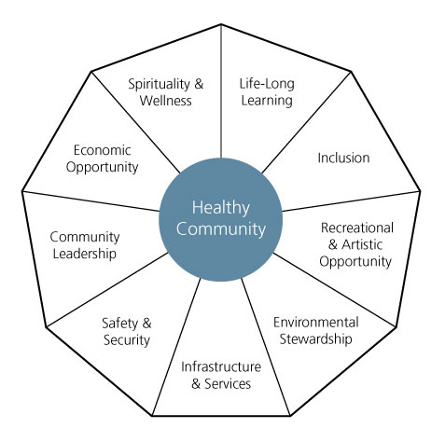
9 Dimensions of Healthy Community

Slide 12
Lesson #4:
Relationships matter
Notes:
Lesson 4: Relationships matter
Sustainable community action is anchored in the quality ad diversity of its connections or relationships.
At the Blandin Foundation we have a saying that goes like this: Change follows relationships and happens at the speed of trust. To identify and leverage the leadership within rural communities you have to:
Take the time to build relationship with the communities you want to serve. At the Blandin Foundation, we say that our program begins with recruitment.
Invest time & energy needed to create relationship with communities we serve. 6-9 months
Use of local steering committees
Assist communities to build sustainable relationships. In BCLP our design is created to broaden and deepen relationships among the cohort to increases individual awareness and connection to community and help build resilience.
Intentional relationship building
Residential cohort model
Smaller scale of the community
Help build critical mass to support collective action
Supportive group when back home
Culture of hospitality

Slide 13
Lesson #5:
You have to do it yourself:
but you can’t do it alone

Slide 14
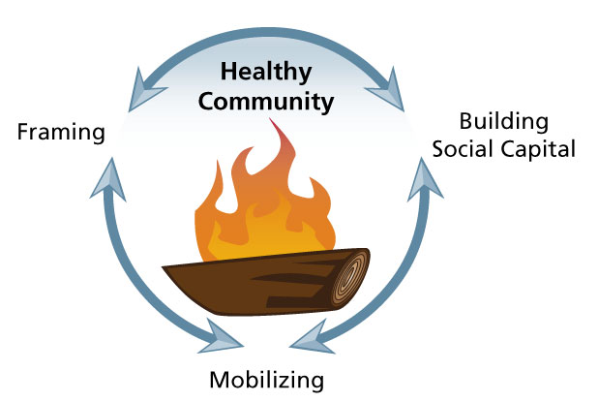
Core Competencies of Community Leadership
Notes:
Lesson 5: You have to do it yourself, but you can’t do it alone:
3 Core Competencies – provide a frame work for attending to what gets done and HOW it gets done.
Framing is a core leadership competency that requires listening to others and creating shared meaning around important issues. How an issue is framed influences action choices.
Building Social capital is the network of relationships community leaders use to get things done. The more social capital you have - the broader and deeper your relationships - the more likely it is you can tap others to help you get things done.
Mobilization is how we bring together well framed issues and enough social capital to make something happen. Mobilization is about action.

Slide 15
Lesson #6:
Attend to personal wellness
Notes:
Lesson 6: Personal wellness of leaders is vital
Our newest dimension, Spirituality and Wellness, is one of our most recent lessons learned. Until recently, we focused largely on relationship and skill building. Based on feedback from our alumni, we incorporated this new dimension last year and have begun to talk about the importance of taking time to be reflective, maintain balance in all we do, and cultivating resiliency as leaders.
Our definition of resilience: the capacity of individuals to sustain their well-being in the face of dramatically changed circumstances.
The Four Elements of Resilient Leadership
Balance: Resilient leaders make time for activities that revitalize them physically, emotionally, spiritually, and intellectually.
Choice: Resilient leaders make intentional choices about when, whether, and to what extent to be involved in projects that arise.
Support: Resilient leaders are active in their efforts to build networks of support to sustain them in their work and contribute to their renewal.
Perspective: Resilient leaders actively strive to see the “big picture” of the community - its achievements and strengths and its assets and barriers.

Slide 16
Healthy, Hopeful
Rural Communities
Thank You!

