Slide 2
Agenda
Welcome
  Why we became a Blandin Broadband Community
  Lezlie Sauter, chair/leader
The Intelligent Community Framework
  Blandin Team
Community Discussions
  By Intelligent Community Element
Group Reporting
  Assets and Gaps
  Desired Outcomes
Next Steps
Adjourn

Slide 3
Community Opportunity

Slide 4
Achieving BBC Success
Amazing Results
Ideas
Resources
Leadership

Slide 5
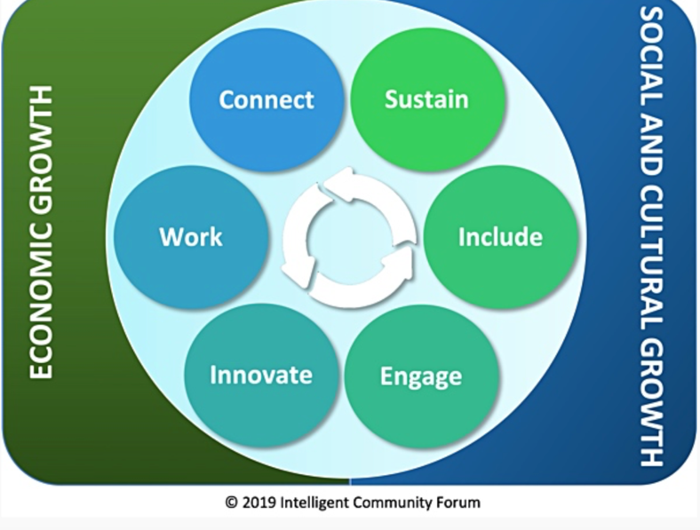
The Intelligent Community Framework

Slide 7
Broadband Discussion
How is your broadband?
  In the cities and towns
  In the rural countryside
  For schools, governments and health care
  For business
  Via cellular
Where is Wi-Fi available?
Who are the key players in this discussion?

Slide 8
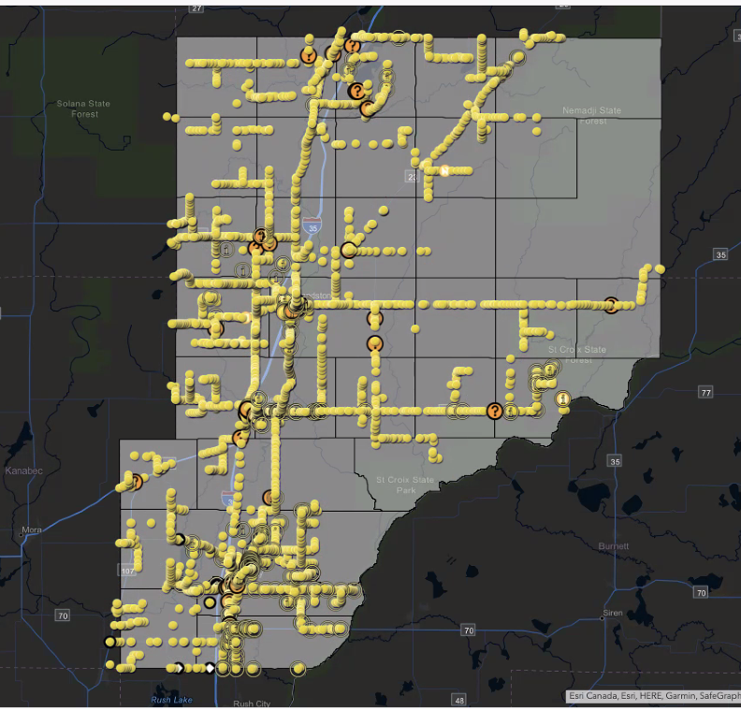
Our Broadband Story
86th out of 87 counties for wireline speeds that meet the state goal of 25 Mbps down and 3 Mbps up.
Fiber exists in the ditches but is not connected to residences
“Our internet is terrible, and we are just yards off of highway 61. My kids were quarantined due to covid for 24 days and each day we would have to load up and sit in the local McDonald's parking lot because our internet wouldn't load their Google classrooms.”

Slide 9
Community Survey Response
85% are not satisfied with how reliable their service is
74% “make it work” with hotspots, DSL and satellite
15% cite cost as the reason they do not have internet
Others say the available speed and poor reliability isn’t worth the cost
$26-75/month is the price range people would like to see

Slide 10


Slide 11
Knowledge Workforce Discussion
How would you describe your local workforce?
What are the strengths?
What are the shortcomings?
What assets do you have for improving workforce skills and availability?
Who are the key players in this discussion?

Slide 12
Our Workforce Story
Current population = 29,359
Median age = 45.8 years (state = 38.3)
89.4% with high school diploma (state = 92.4%)
7.8 % unemployment rate (state = 6.2%)
1168 unemployed workers
Labor force projected to decline from 13,403 to 12,570 from 2020-2030
Total labor force = 13,452
Highest unemployment rate among 16-19 & 20-24
Pine Technical & Community College
Workfast
Pine County College Initiative

Slide 13
Community Survey Response
Those with NO internet or ONLY cellular hotspots were asked: “If you had internet access at this location, would you use it for:”
  54/155 (35%) said for Education
  73/155 (47%) said to Earn Income
113/608 (18%) of Pine County respondents either:
  Work from home
  Operate a home business
  Attend school online
“Pine County will see exponential growth as more and more individuals decide to move north; as well as the shift in culture where younger adults want to stay closer to home with the uncertainty of the world around them. Speaking from recruiting experience, we are seeing phenomenal pools of candidates from both local and commutable distances. During the interview process, candidates want to relocate to this area but express concern with the lack of local business (options), housing, and internet service. Those three areas must be focused on to retain and maintain a high-quality workforce.”

Slide 14

Include
Digital equality means computers, skills, and access for all!

Slide 15
Digital Equity Discussion
Who in the community is being left behind on technology?
What are the biggest challenges?
  Internet connectivity
  Computers and devices
  Skills
How can the responses made during the pandemic be carried forward?

Slide 16
Our Digital Equity Story
Most cities are connected to higher-speed reliable broadband
Schools
Health care systems
Government buildings
Rural residents & townships are not well connected
Cellular service is currently an unreliable source for data
Unavailable in remote areas
Fiber exists but isn’t used to full capacity or with upgraded equipment

Slide 17
Community Survey Response
44% of survey respondents indicated that they do not have fixed internet because it IS NOT OFFERED
“As the library system that serves Pine County, we hear regularly from patrons who have trouble accessing broadband. Our hotspot loan program has been a help, but it's not enough.”
“I, personally, was not able to sell some real estate in Partridge Township when I had a willing buyer who found out how bad the internet access was. I believe this happens more often than we know.”

Slide 18

Innovation
Innovation refers to doing new things and doing old things in new and better ways

Slide 19
Innovation Discussion
Which people or organizations in the community are doing great things with technology?
Which sectors/organizations are falling behind?
What are we doing to support entrepreneurs?
How does our community handle change?

Slide 20
Our Innovation Story
Local units of government stream meetings
County
School Districts
Some cities
Pine County History Center streams events
Offering smart phone training
Large gatherings offered in hybrid format
Region 7E Broadband Conference
Inventors & Entrepreneurs Club
Pine City Area Chamber of Commerce
Social media & google mapping training
East Central Regional Library
Hotspots available for 2 weeks (check-out like books)
Offer training on digital devices (ipads, phones, computers)
Locations in Pine City, Hinckley, Sandstone

Slide 21

Community Survey Response
Pine County residents have knowledge and capabilities but…
“I wish it was possible for my family to have a smart house. It would make me feel safer to get a reliable internet connection at the speeds we would like to have for our big family. During the pandemic, it became clear to us that our internet was in our favor. We had two of our family members working from home. While one would be in a meeting, the other would not be able to do anything. We had to disconnect everything from our internet if we wanted to try to have a good signal and make sure that the internet itself didn't drop off from having too many connections. We can't make our house a smart home due to not being able to have a lot of devices connected as it slows down the traffic due to having so many on our network.”

Slide 22
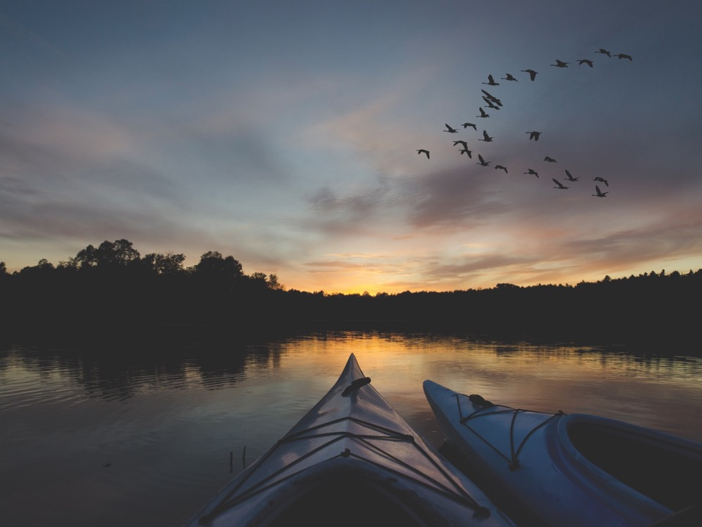
Sustainability is economic development with the future in mind

Slide 23
Sustainability Discussion
Has the community had conversations about sustainability as an important goal?
Which local organizations have included sustainability in their operating practices, including ongoing measurement of energy use, carbon footprint or waste reduction?

Slide 24
Our Sustainability Story
More people are working from home & not commuting as much
Pine County businesses and organizations are seeking ways to be sustainable (solar installations, etc.)
A plastic bags-for-benches program in Pine City was quite successful.

Slide 25
Community Survey Response
Many people desire utilizing sustainable resources such as geothermal or solar, but cost greatly impacts the ability of the average of Pine County resident to do so.
A plastic bags-for-benches program in Pine City was quite successful.
Making sustainability programs known and easy to participate would help.
Fast reliable internet is none negotiable. Sustainability is not something you discuss when it should be considered a basic need. As an example, we don't seem to discuss sustainably for electricity. This is simply something we know we get.

Slide 26

Engage

Slide 27
Community Engagement Questions
How do local organizations communications with community members? Is this a two-way discussion? How is technology used?
What are the messages, and through which means are they transmitted, is the community sending out to the world to attract people and investment?

Slide 28
Our Community Engagement Story
January 2021: Pine County Board of Commissioners identified broadband as one of its top priorities.
February 2021: Over 50 community members shared their broadband stories at a special meeting with County Commissioners
March - June 2021: 19 community members participated for 15 weeks in gaining broadband leadership education, gathering local broadband information and establishing broadband goals as a community.
July 2021: Pine County hosted meetings with cities and townships regarding the American Rescue Plan Act funding and eligibility of broadband.
September 2021: Over a dozen community leaders have agreed to help steer the community's vision for improving access to technology & broadband, by identifying projects throughout the County which can use Blandin grant funds to execute their community's plans.
News releases of all milestones & facebook posts sharing progress

Slide 29
Community Survey Response
We have one of the best state parks white water rafting in the Midwest. Vacationers are not happy with slow Internet service when they try to send videos or photos of their adventures.
Also, we have an outstanding environmental center with over 4000-7000 people attending in one year. The number one complaint by most was slow Internet service.
A number of organizations in Pine City are using social media well to connect with users and constituents.

Slide 30
Small Group Discussion
What are our strengths in this area?
Where are our gaps in this area?
What could we hope to accomplish in the next 18 months (our desired outcomes) that would really make a positive difference in our community?

Slide 31
Discussion Group Reporting

Slide 32
Next Steps
Brainstorm Meeting
Project voting and volunteering
Project development and budgeting
Blandin grant application
Implementation

Slide 33
Adjourn

