Slide 1
Adapting Boards for a New Day
Kate Barr, Executive Director
Nonprofits Assistance Fund

Slide 2
Boards for a New Day
Textbook boards
Defined structure & roles
Planning and oversight role
Significant reporting & monitoring activities
Recruit for skills & contacts
Who do you know
Priority on fundraising
External ambassador
Adaptive boards
Evolving structure
Engagement role
Activities adapt to changing needs, delegate authority
Recruit for skills, relationships, and strategy
Priority on sustainability
External connector

Slide 3
Governance
Governance is how the board of directors and executive work together to ensure the success of the organization.
Good governance is intentional

Slide 4

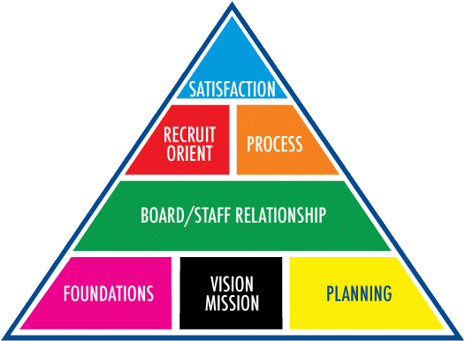
Board Effectiveness
Source: Boards that Excel

Slide 5
Source: Boards that Excel

Slide 6
Foundations
By-laws: membership, officers, term limits
Legal requirements
Reporting and registration
Human resources
Policies, including conflict of interest

Slide 7
Vision & Mission
Stated purpose of organization
Vision for the future
Shared values
Clear understanding of direction

Slide 8
Planning
Strategic view or plan
Goals and objectives
Implementation plans and actions
Annual budget
Process for setting priorities
Method for monitoring progress

Slide 9
Board Fundamentals
Non-negotiable responsibilities
Mission and direction
Legal responsibilities for reporting and compliance
Stewardship of resources
Human resource oversight
Duty of Care
Duty of Loyalty
Duty of Obedience

Slide 10
Source: Boards that Excel

Slide 11
Relationships
Boards are teams
Executive Director to Board
Board member to board member
Staff to board members
Board chair to board members
Board chair to Executive Director

Slide 12
What helps boards work well together?
Common values, passion & commitment
Connection & informality
Systems & structure
Communications
Mutual respect
Good leadership & facilitation
Clarity of roles
Support from staff & ED
Source: Coloring Outside the Box, Vanderwall & Benevides

Slide 13
Board – Executive Director
Select and hire executive director
Set compensation
Clear expectations
Roles and authority
Supervise and develop
Feedback and performance review

Slide 14
Power & Authority
CEO dominated boards
Chair dominated boards
Fragmented boards
Powerless boards
Power-sharing boards

Slide 15
Both Hands on the Wheel
10 Commitments for Board Chair/Executive Director relationship
Keep everyone focused on mission
Define & respect each other’s roles
Avoid territorial behavior
Add “innovative’ value
Help to make the board stronger

Slide 16
Board Chair/Executive Director
10 Commitments
Develop positive dynamic between staff and baord
Make communications a priority
Maintain a united front
Protect and support one another
Keep passions & emotions in check

Slide 17
Wish Lists
Executive Director/staff wish list:
Other than money, what do you wish your board could provide?
Board member wish list:
What do you wish the Executive Director would do to engage you with the organization?

Slide 18
Source: Boards that Excel

Slide 19
Board Composition
Founding boards
Representational boards
Appointed boards
Elected boards
Self-nominating boards
Legacy boards

Slide 20
Recruiting & Orienting
Who is on the board?
Do we have the right people?
Do they know their job?
Is the board organized in a way that they can do their job well?

Slide 21
Board Matrix
Typical board matrix - skills
 | Community | Legal | Finance | Fundraising | Marketing
Bill |  | x | x
Susan | x |  |  |  | x
Jennifer |  |  |  |  | x
Robert |  |  |  | x
Martin | x |  |  | x

Slide 22
Board Matrix
New board matrix – strategic goals
 | Mission/values | Expand program | Collaborate services | Enhance impact | Stable infrastructure
Bill |  |  |  |  | x
Susan | x |  | x | x
Jennifer | x | x |  | x
Robert | x |  | x |  | x
Martin | x |  | x |  | x

Slide 23
Board Process
Who is on the board?
Do we have the right people?
Do they know their job?
Is the board organized in a way that they can do their job well?

Slide 24
Board Meetings
Do board meetings help achieve goals?
Board calendar
Meeting preparation
Board agendas
Executive session
Board retreats

Slide 25
Committees
Each committee has a purpose
Standing committees
Executive committees
Ad hoc task forces
Committees with authority
Committees and the board

Slide 26
Board Process
Do all board meetings have meaningful discussion and/or actions?
Are most board members present at and prepared for board meetings?
Do board committees conduct activities that are vital to achieving mission and strategic goals?
What would you do differently?

Slide 27
Source: Boards that Excel

Slide 28
Board Member Satisfaction
Why do board members serve?
Commitment/interest in mission
Relationships
Personal satisfaction and purpose
Engaging board members
Inspiring board members
Whose role is it to inspire and excite board members?

Slide 29
Board Evaluation
Regular topic for discussion
Opportunities for candid feedback
Board sets goals for performance
Annual evaluation of board performance
Formal board evaluation process

Slide 30
Five questions for every board
Why are we here?
How do we define success?
How can this board be of most value to the organization?
What behavior are we settling for?
What five things should we track?
Who else?
What else?

Slide 31
The New Work of Boards
Fiduciary
Strategic
Governance
As Leadership
Generative
Source: Chait, Ryan & Taylor

Slide 32

Fiduciary
Controls and oversight
What is wrong/right?

Slide 33
Fiduciary Mode
Establish and assure mission focus
Ensure legal compliance
Ensure fiscal accountability
Hire and evaluate CEO
Oversee operations
Monitor results
Add value by connecting questions to mission, vision & values

Slide 34

Strategic
Direction and goals
What is the future of the organization and what is the plan?

Slide 35
Strategic Mode
Scan internal & external environments
Review, modify and assist strategic planning
Help develop resources and sustainable business model
Assess performance with critical success factors
Add value by asking broad and forward thinking questions, open to new and different answers

Slide 36

Generative
Sense-making and problem framing
What is the right question?

Slide 37
Generative Mode
See current challenges in a new light
Perceive “better” problems & opportunities
Discover strategies, priorities and realities
Tap intuition and creativity
Encourage robust discourse, not quick consensus
Add value by building trust, taking risks, searching out and using new information & ideas

Slide 38
Boards in the Community
Inside boards: focus on internal activities and goals
Institutional boards: focus on reputation and fundraising
Connector boards: focus on boundary spanning
Networked boards: focused on interconnections

Slide 39
Boards for a New Day
Textbook boards
Defined structure & roles
Planning and oversight role
Significant reporting & monitoring activities
Recruit for skills & contacts
Who do you know
Priority on fundraising
External ambassador
Adaptive boards
Evolving structure
Engagement role
Activities adapt to changing needs, delegate authority
Recruit for skills, relationships, and strategy
Priority on sustainability
External connector

Slide 40
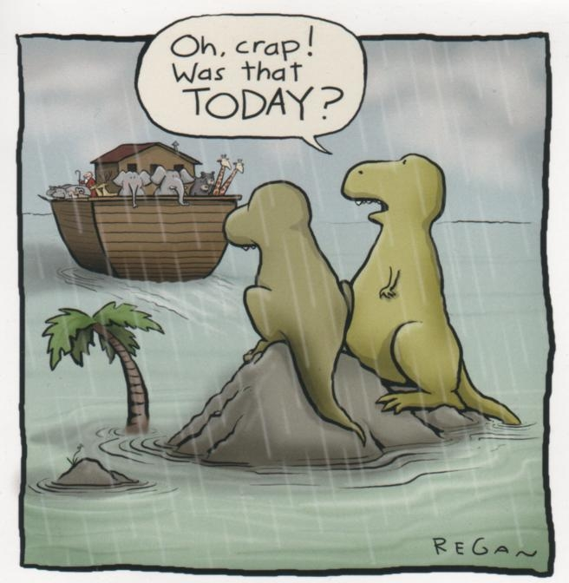
It’s a New Day

