Slide 1
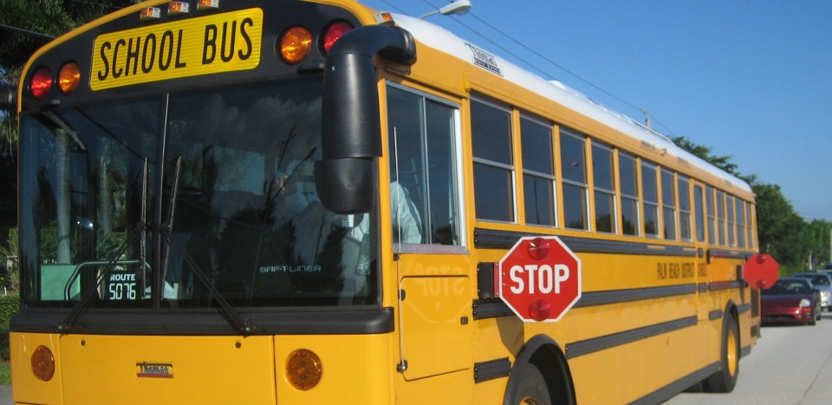
Beyond Brick Buildings:
How Wi-Fi-Equipped buses can expand the classroom and help level the playing field for rural students

Slide 2
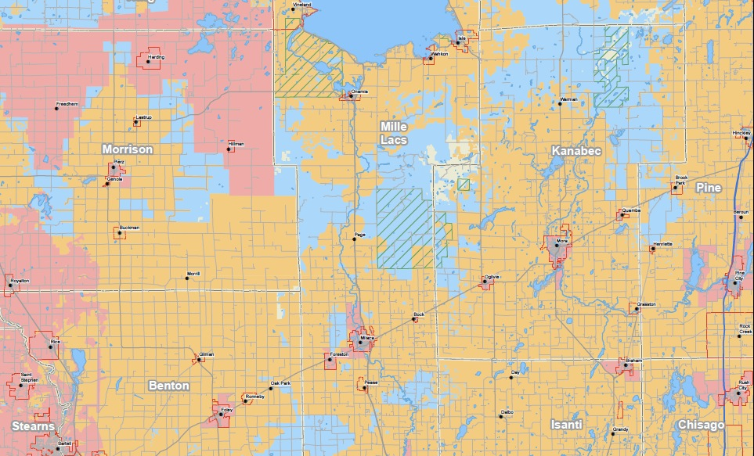
Broadband and Mille Lacs County

Slide 3
Three Goals of Wi-Fi Bus Project
1. Improve the Bus Environment
2. The Bus as a Rolling Classroom
3. Increase Digital Inclusion for Rural Students

Slide 4
Steve Bistrup
Technology Coordinator
Milaca Public Schools
steve.bistrup@milaca.k12.mn.us

